Slide 1
TEAM-D EXAM HALL MANAGEMENT SYSTEM
GUIDED BY, Team members
Mrs.V.EZHILARASi M.E (ph.d) KALANITHI.M (820319205014)
Assistant professor, Gokulakrishnan .v (820319205011)
DEpARTMENT OF INFORMATION TECHNOLOGY Mohamed jasim. J (820319205021)
Date: 22.06.2022 BRANCH: INFORMATion technology

Slide 2
ABSTRACT
The Examination Hall System is a PHP project that can automate the process of exam allotment and seating arrangement. The software facilitates the examination by assigning each student and staff to their respected classes and allocating the seating arrangement to avoid conflict. Mainly, this system helps students and faculty to know their rooms for the examination.

Slide 3
SOFTWARE REQUIREMENTS
SOFTWARE REQUIREMENTS:
FRONT END: HTML,CSS, JAVASCRIPT
BACK END: PHP,SQL
OPERATING SYSTEM: WINDOWS 7 (or) WINDOWS 10
IDE : XAMPP SERVER

Slide 4
HARDWARE REQUIREMENTS
HARDWARE REQUIREMENTS:
PROCESSOR: INTEL CORE 13
RAM: 4GB
HDD: 1TB
MONITOR: 15” COLOR MONITOR

Slide 5
CHALLENGES IN EXISTING SYSTEM
Existing system is very slow and inefficient. Report generation is also not an easy task in the current situation.
Also if the report is generated then calculations are done manually that leads to more errors.
There is a lot of manual work involved in current system and mistake in one detail can lead to wrong generation of page.
No proper collection of requirements leads a huge problem for this system.
This system is to enhance manual work and also more energy is wasted to allocate the seating arrangement.

Slide 6
DRAWBACKS OF EXISTING SYSTEM
The drawbacks that are present in the existing system are listed below:
Current system is manual so all the records are maintained manually. So the seating arrangement of students cannot be determined if updating is not done.
Time Consuming
Less Efficient
More manual Work Required
Less Accurate
Not User Friendly
Difficult in hall ticket generation

Slide 7
ARCHITECTURE OF PROPOSED SYSTEM
EXAMINATION HALL MANAGEMENT SYSTEM is developed for the college to simplify the allocation of halls and issuing hall tickets to students during exams.
It facilitates to access the examination information of a particular student in a particular department. The information is sorted information alphabetically, which will be provided by the staff for a respective department.
This system is also help in finding the 11 examination eligibility criteria of a student of the particular department.

Slide 8
ADVANTAGES IN PROPOSED SYSTEM
Develop software such that everybody working in exam hall allocation system can handle easily.
Admin can store & retrieve data easily. And hence, keeping these major target segments in focus, the system was developed.
Report can also provided through print outs.
Provide a simpler method to store and access information related to exam hall and students.
Provide a simple interface which will be easily used without much training.
Reduce paperwork and make all related information accessible easily..

Slide 9
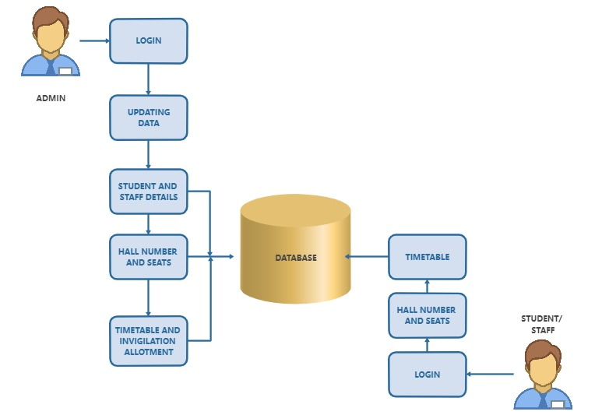
ARCHITECTURE DIAGRAM

Slide 10
MODULES OF THE PROJECT
ADMIN MODULE
STAFF MODULE
STUDENT MODULE

Slide 11
MODULE DESCRIPTION
ADMIN MODULE:
In this module, admin will manage the data of time table and exam hall allocation.
Admin can access and manage the details of the student and faculty.
The details means that admin providing user credentials.

Slide 12
MODULE DESCRIPTION
STAFF MODULE:
In this module, staff can login using the details. They can view the time table and allotted hall for the examination.
Staff can view students details who are going to write in their allotted room.
So, Staff may easily find out their allotted room.

Slide 13
MODULE DESCRIPTION
STUDENT MODULE:
In this module, students can login using their credentials which have been provided.
They can view the time table and allotted hall for the examination.
Admin provides user credentials to students like staff.

Slide 14
IMPLEMENTATION AND SCREENSHOT

Slide 15
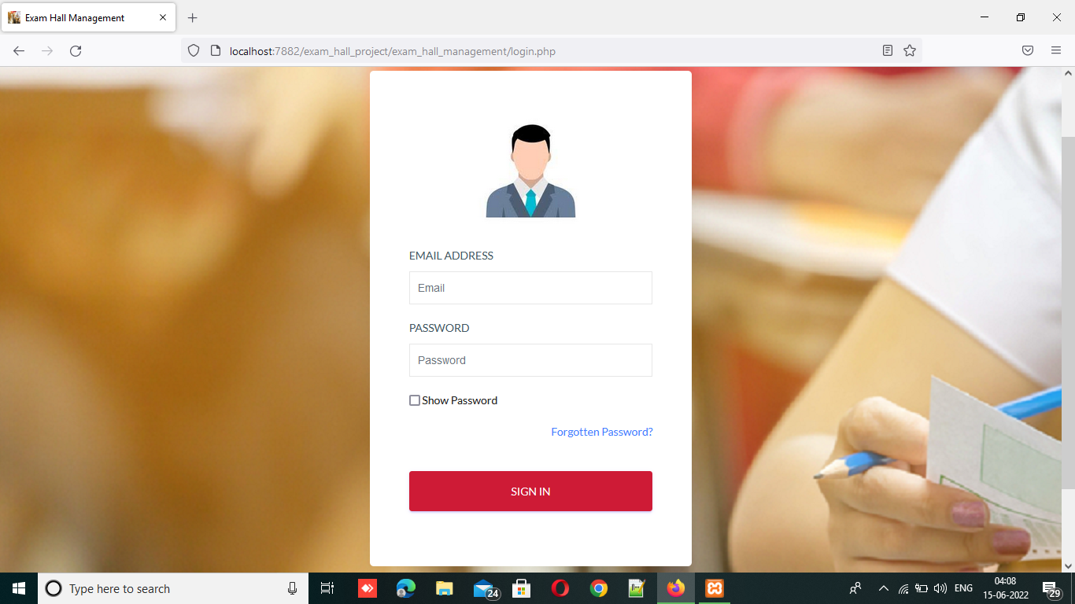

Slide 16
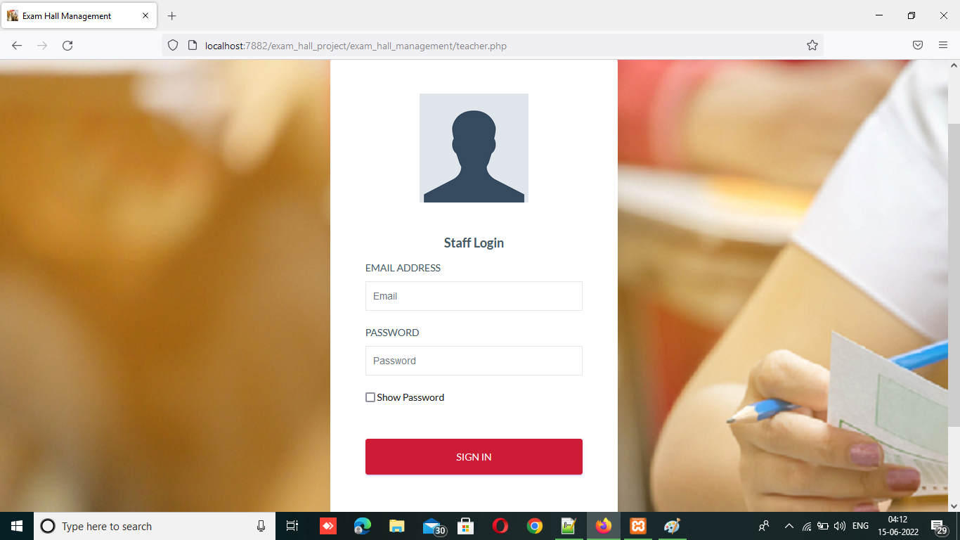

Slide 17


Slide 18
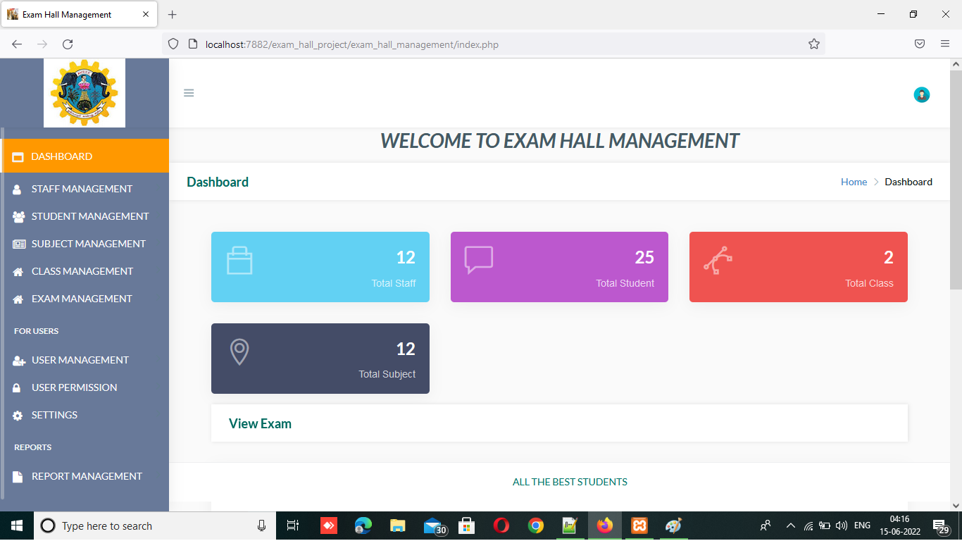

Slide 19
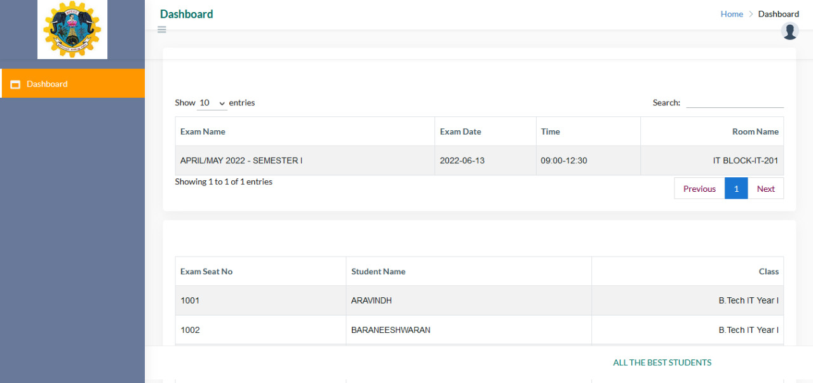

Slide 20
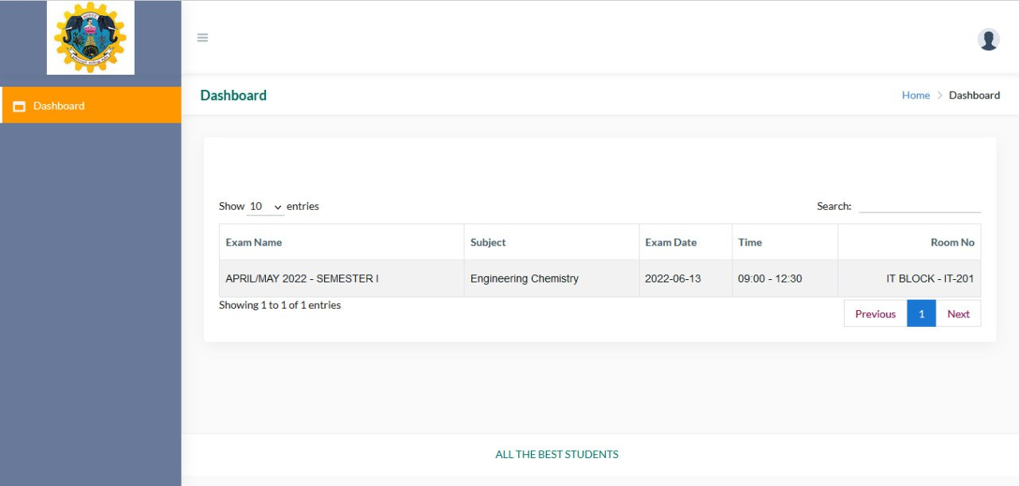

Slide 21
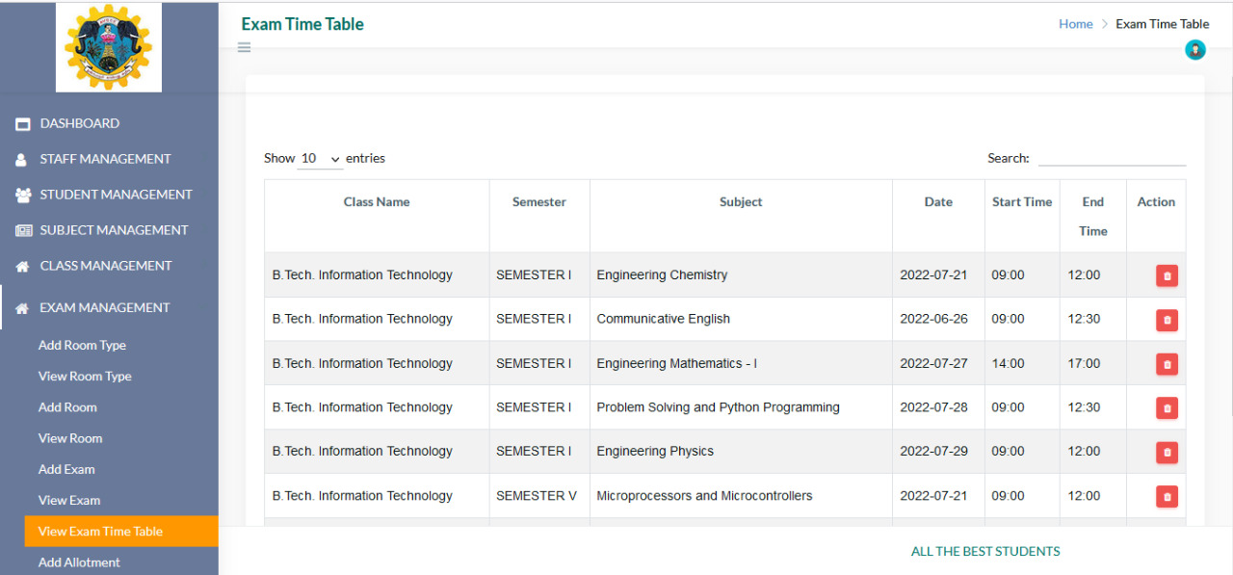

Slide 22
CONCLUSION
It is concluded that the application works well and satisfy the end users. The application is tested very well and errors are properly debugged.
The application is simultaneously accessed from more than one system. Simultaneous login from more than one place is tested.
This system is user friendly so everyone can use easily. Proper documentation is provided.
The end user can easily understand how the whole system is implemented by going through the documentation. The system is tested, implemented and the performance is found to be satisfactory.
All necessary output is generated. Thus, the project is completed successfully.

Slide 23
FUTURE WORK
In the future, we will add new features to this project such as integrating this patform with placement cell, to actively require by updating students depend upon the company’s criteria, to make active all passed out students to join this forum while there off.

Slide 24
REFERENCES
Yepuri.v.k,pamu.c.g.,kodali.n&pradyuma.l.v(2019).”Examination Management automation system” International research Journal of engineering and technology,05(04) www.irjet.net.
Prosanta kumar chaki,shikha ”Anirban algorithm for efficient seating plan for centralized exam system” International conference on computational technique in information and communication technologies (ICCTICT),2018.
S.PriyaDharshini, M.SelvaSudha from the Department of computer science engineering has proposed the system termed as “Exam Cell Automation System” in 2017.

Slide 25
THANK YOU

